Slide 1
Software Tests
Software must be tested to allow errors to be identified and removed before delivery to the customer.
Engineer creates a series of test cases that are intended to "demolish" software that has been built!

Slide 2
Software Tests
Destructive rather than constructive step!!
Developer should discard preconceived notions of the correctness of software developed
Overcome a conflict of interest that occurs when errors are uncovered.

Slide 3
Testing Objectives:
Testing is a process of executing a program with
the intent of finding an error.
2. A good test case is one that has a high probability of finding
an as yet undiscovered error.
3. A successful test is one that uncovers an as-yet-
undiscovered error.
Counter view- “a successful test is one in which no errors are found”.

Slide 4
Testing Objectives:
If testing is conducted successfully, it will uncover errors in the software.
Testing demonstrates that software functions appear to be working according to specification
(behavioral and performance requirements are met)
Testing cannot show the absence of errors and defects, it can show only that software errors and defects are present.

Slide 5
Testing Principles:
• All tests should be traceable to customer requirements.
• Tests should be planned long before testing begins.
• The Pareto principle applies to software testing.
The Pareto principle implies that 80 percent of all errors uncovered during testing will likely be traceable to 20 percent of all program components.
The problem, of course, is to isolate these suspect components and to thoroughly test them.

Slide 6
Testing Principles:
• Testing should begin “in the small” and progress toward testing “in the large.”
• Exhaustive testing is not possible.
• To be most effective, testing should be conducted
by an independent third party.

Slide 7
Attributes of a “good” test:
1. A good test has a high probability of finding an error.
2. A good test is not redundant.
Testing time and resources are limited.
There is no point in conducting a test that has the same purpose as another test.
Every test should have a different purpose

Slide 8
Attributes of a “good” test:
For example, a module of the SafeHome software is designed to recognize a user password to activate and deactivate the system. In an effort to uncover an error in password input, the tester designs a series of tests that input a sequence of passwords. Valid and invalid passwords (four numeral sequences) are input as separate tests. However, each valid/invalid password should probe a different mode of failure. For example, the invalid password 1234 should not be accepted by a system programmed to recognize 8080 as the valid password. If it is accepted, an error is present. Another test input, say 1235, would have the same purpose as 1234 and is therefore redundant. However, the invalid input 8081 or 8180 has a subtle difference, attempting to demonstrate that an error exists for passwords “close to” but not identical with the valid password.

Slide 9
Attributes of a “good” test:
3. A good test should be “best of breed”.
In a group of tests that have a similar intent, time and resource limitations may mitigate toward the execution of only a subset of these tests.
In such cases, the test that has the highest likelihood of uncovering a whole class of errors should be used.

Slide 10
Attributes of a “good” test:
4. A good test should be neither too simple nor too
complex.

Slide 11
Levels of Testing
Unit Testing
Integration Testing
System Testing

Slide 12
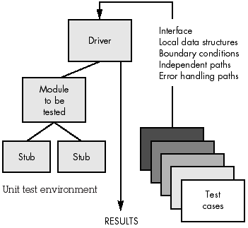
Unit Testing

Slide 13
main(){
int i = 8;
factorial (i);
//gcd(i);
//lcm(i);
.
}
factorial (int i){
int x;
for(x = 0;x<I;i++){
…………
}
}
gcd(int x){
printf(“A dummy”);
}
lcm(int x){
printf(“A dummy”);
}

Slide 14
TEST CASE DESIGN
Tests are designed that have the highest likelihood of finding the most errors with a minimum amount of time and effort.

Slide 15
TEST CASE DESIGN
If (x >y)
max = x;
else
max = x;
Test case that does not detect error: {(x = 3, y = 2); (x = 4, y = 3);(x = 5, y = 1)}
Test case to detect error: {(x = 3, y = 2); (x = 2, y = 3)}

Slide 16
Black-box Testing
Also called behavioral testing
Test cases designed from examination of input and output values only
No knowledge of design or code of logical structure

Slide 17
Black-box Testing
Black-box testing uncovers a different class of
errors:
Incorrect or missing functions
Interface errors
Behavior or performance errors
Initialization and termination error
Errors in data structures or external database access,

Slide 18
Black-box Testing
Types:
Equivalence Partitioning
Boundary Value Analysis

Slide 19
i. Equivalence Partitioning
Divides the input domain of a program into classes of data from which test cases can be derived.
An equivalence class represents a set of valid or invalid states for input conditions!!

Slide 20
i. Equivalence Partitioning
Specific numeric value
range of values
Input condition
set of related values
Boolean condition

Slide 21
i. Equivalence Partitioning
Equivalence classes may be defined according to the following guidelines:
i. Input condition specifies a range, one valid and two invalid equivalence classes are defined.
ii. Input condition needs specific value, one valid and two invalid equivalence classes defined.

Slide 22
i. Equivalence Partitioning
iii. Input condition specifies member of a set, one valid/one invalid equivalence class defined.
iv. Input condition is Boolean, one valid and one invalid class are defined.

Slide 23
i. Equivalence Partitioning
As an example, consider data maintained as part of an automated banking application. The user can access the bank using a personal computer, provide a six-digit password, and follow with a series of typed commands that trigger various banking functions. During the log-on sequence, the software supplied for the banking application accepts data in the form
i. area code—
ii. prefix—
iii. suffix—
iv. password—
v. commands—
Blank or three-digit number

Slide 24
i. Equivalence Partitioning
The input conditions associated with each data element for the banking application can be specified as:
i. area code:
ii. prefix:
iii. suffix:
iv. password:
v. command:
Input condition, Boolean-area code may/may not be present.
Input condition, range—values defined between 200 and 999,
with specific exceptions.

Slide 25
i. Equivalence Partitioning
As an example, consider data maintained as part of an automated banking application. The user can access the bank using a personal computer, provide a six-digit password, and follow with a series of typed commands that trigger various banking functions. During the log-on sequence, the software supplied for the banking application accepts data in the form
i. area code—
ii. prefix—
iii. suffix—
iv. password—
v. commands—
Blank or three-digit number
Three-digit number not beginning with 0 or 1

Slide 26
i. Equivalence Partitioning
The input conditions associated with each data element for the banking application can be specified as:
i. area code:
ii. prefix:
iii. suffix:
iv. password:
v. command:
Input condition, Boolean-area code may/may not be present.
Input condition, range—values defined between 200 and 999,
with specific exceptions.
Input condition, range—specified value >200

Slide 27
i. Equivalence Partitioning
As an example, consider data maintained as part of an automated banking application. The user can access the bank using a personal computer, provide a six-digit password, and follow with a series of typed commands that trigger various banking functions. During the log-on sequence, the software supplied for the banking application accepts data in the form
i. area code—
ii. prefix—
iii. suffix—
iv. password—
v. commands—
Blank or three-digit number
Three-digit number not beginning with 0 or 1
Four-digit number

Slide 28
i. Equivalence Partitioning
The input conditions associated with each data element for the banking application can be specified as:
i. area code:
ii. prefix:
iii. suffix:
iv. password:
v. command:
Input condition, Boolean-area code may/may not be present.
Input condition, range—values defined between 200 and 999,
with specific exceptions.
Input condition, range—specified value >200
Input condition, value—four-digit length

Slide 29
i. Equivalence Partitioning
As an example, consider data maintained as part of an automated banking application. The user can access the bank using a personal computer, provide a six-digit password, and follow with a series of typed commands that trigger various banking functions. During the log-on sequence, the software supplied for the banking application accepts data in the form
i. area code—
ii. prefix—
iii. suffix—
iv. password—
v. commands—
Blank or three-digit number
Three-digit number not beginning with 0 or 1
Four-digit number
Blank or six digit alphanumeric string

Slide 30
i. Equivalence Partitioning
The input conditions associated with each data element for the banking application can be specified as:
i. area code:
ii. prefix:
iii. suffix:
iv. password:
v. command:
Input condition, Boolean-area code may/may not be present.
Input condition, range—values defined between 200 and 999,
with specific exceptions.
Input condition, range—specified value >200
Input condition, value—four-digit length
Input condition, Boolean-password may/may not be present.
Input condition, value—six-character string.

Slide 31
i. Equivalence Partitioning
As an example, consider data maintained as part of an automated banking application. The user can access the bank using a personal computer, provide a six-digit password, and follow with a series of typed commands that trigger various banking functions. During the log-on sequence, the software supplied for the banking application accepts data in the form
i. area code—
ii. prefix—
iii. suffix—
iv. password—
v. commands—
Blank or three-digit number
Three-digit number not beginning with 0 or 1
Four-digit number
Blank or six digit alphanumeric string
check, deposit, bill pay, and the like

Slide 32
i. Equivalence Partitioning
The input conditions associated with each data element for the banking application can be specified as:
i. area code:
ii. prefix:
iii. suffix:
iv. password:
v. command:
Input condition, Boolean-area code may/may not be present.
Input condition, range—values defined between 200 and 999,
with specific exceptions.
Input condition, range—specified value >200
Input condition, value—four-digit length
Input condition, Boolean-password may/may not be present.
Input condition, value—six-character string.
Input condition, set-containing commands noted previously.

Slide 33
A software that computes square root of an input integer that assumes values between 0 and 5000
Equivalent Classes
Set of -ve integers
Set of integers between 0 and 5000
Set of integers > 5000
Possible Test Set:
{-5,500,6000}

Slide 34
ii. Boundary Value Analysis
A greater number of errors tends to occur at the boundaries of the input domain rather than in the "center"
Boundary value analysis leads to a selection of test cases that exercise bounding values.
BVA leads to the selection of test cases at the "edges" of the class.

Slide 35
Guidelines for BVA:
1. If an input condition specifies a range bounded by values a and b, test cases should be designed with values a and b and just above and just below a and b.
2. If an input condition specifies a number of values, test cases should be developed that exercise the minimum and maximum numbers. Values just above and below minimum and maximum are also tested.

Slide 36
Guidelines for BVA:
3. Apply guidelines 1 and 2 to output conditions.
For example, assume that a temperature vs. pressure table is required as output from an engineering analysis program. Test cases should be designed to create an output report that produces the maximum (and minimum) allowable number of table entries.
4. If internal program data structures have prescribed boundaries (e.g., an array has a defined limit of 100 entries), be certain to design a test case to exercise the data structure at its boundary.

Slide 37
int arr[5]={2,4,3,2,1};
for (i = 0;i<4;i++){
if( arr[5]== 1)
printf(“Element found”);
}
int arr[5]={2,4,3,2,1};
for (i = 0;i<5;i++){
printf(“%d”, arr[i]);
}

Slide 38
ii. Boundary Value Analysis
A function that computes square root of input integer in the range between 0 and 5000
Possible Test Case:
{0,-1,5000,5001}

Slide 39
Testing GUIs
Finite state modeling graphs may be used to derive a series of tests that address specific data and program objects that are relevant to the GUI.
Use of automated tools.

Slide 40
Testing of Client/Server Architectures
Difficulties in testing of C/S architectures and the software:
- The distributed nature of client/server environments
- The performance issues associated with transaction processing,
- The potential presence of a number of different hardware platforms,
- The complexities of network communication
- The need to service multiple clients from a centralized (or in some cases, distributed) database, the coordination requirements imposed on the server all combine to make

Slide 41
Testing for Real-Time Systems
The time-dependent, asynchronous nature of many Real-time applications adds a new and potentially difficult element to the testing mix—time.
Not only does the test case designer have to consider white- and black-box test cases but also event handling (i.e., interrupt processing), the timing of the data, and the parallelism of the tasks (processes) that handle the data.
Four step strategy for testing Real-time Systems:
Task testing, Behavioral testing, Inter-task testing, System Testing

Slide 42
White-box testing
Also called glass-box testing, is a test case design method that uses the control structure of the procedural design to derive test cases.
For even small programs, the number of possible logical paths can be very large.
For example, consider the 100 line program in the language C. After some basic data declaration, the program contains two nested loops that execute from 1 to 20 times each, depending on conditions specified at input. Inside the interior loop, four if-then-else constructs are required. There are approximately 1014 possible paths that may be executed in this program! If a processor can develop a test case, execute it, and evaluate the results in one millisecond. Working 24 hours a day, 365 days a year, the processor would work for 3170 years to test the program.

Slide 43
Using white-box testing methods, the software engineer can derive test cases that:
i. guarantee that all independent paths within a module have been exercised at least once,
ii. exercise all logical decisions on their true and false sides,
iii. execute all loops at their boundaries and within their operational bounds, and
iv. exercise internal data structures to ensure their validity.

Slide 44
Reasons for conducting white-box tests:
• Logic errors and incorrect assumptions are inversely proportional to
the probability that a program path will be executed.
  Errors tend to creep into our work when we design and implement function, conditions, or control that are out of the mainstream.
  Everyday processing tends to be well understood (and well scrutinized), while "special case" processing tends to fall into the cracks.
• We often believe that a logical path is not likely to be executed
when, in fact, it may be executed on a regular basis.
  The logical flow of a program is sometimes counterintuitive, meaning that our unconscious assumptions about flow of control and data may lead us to make design errors that are uncovered only once path testing commences.
• Typographical errors are random.
  When a program is translated into programming language source code, it is likely that some typing errors will occur.

Slide 45
White Box Testing
Guarantee that all independent paths within a module have been exercised at least once,
Exercise all logical decisions on their true and false sides,
iii. Execute all loops at their boundaries and within their
operational bounds
iv. Exercise internal data structures to ensure their
validity.

Slide 46
Reasons:
• Logic errors and incorrect assumptions are inversely proportional to
the probability that a program path will be executed.
Errors tend to creep into our work when we design and implement function, conditions, or control that are out of the mainstream.
Everyday processing tends to be well understood (and well scrutinized), while "special case" processing tends to fall into the cracks.

Slide 47
Reasons :
• We often believe that a logical path is not likely to be
executed when, in fact, it may be executed
on a regular basis!!
The logical flow of a program is sometimes counterintuitive, meaning that our unconscious assumptions about flow of control and data may lead us to make design errors that are uncovered only once path testing commences.

Slide 48
Reasons :
• Typographical errors are random.
When a program is translated into programming language source code, it is likely that some typing errors will occur.

Slide 49
Aims to design test cases so that every statement in a program is executed at least once
int comute_gcd(x,y){
int x,y;
while (x != y){
if(x>y) then
x = x-y;
else
y = y – x;
}
return x;
}
Test set: { (x = 3, y = 3), (x = 4,y = 3), (x = 3,y = 4) }

Slide 50
i. BASIS PATH TESTING
Is white-box testing technique first proposed by Tom McCabe
The basis path method enables test case designer to derive a logical complexity measure of a procedural design and use this measure as a guide for defining a basis set of execution paths.
Test cases derived to exercise the basis set are guaranteed to execute every statement in the program at least one time during testing.

Slide 51
i. BASIS PATH TESTING
a. Flow Graph Notation
b. Cyclomatic Complexity
c. Deriving Test Cases
d. Graph Matrices

Slide 52
a. Flow Graph Notation
A Flow Graph depicts logical control flow using the notations:
Circle: Flow graph node, represents one or more procedural statements.
Arrows: Edges or Links, represent flow of control

Slide 53
a. Flow Graph Notation
A sequence of process boxes and a decision diamond can map into a single node
An edge must terminate at a node, even if the node does not represent any procedural statements

Slide 54
a. Flow Graph Notation
Areas bounded by edges and nodes are called regions.
A compound condition occurs when one or more Boolean operators (logical OR, AND, NAND, NOR) is present in a conditional statement.
Predicate node denoting a condition is characterized by two or more edges emanating from it.

Slide 55
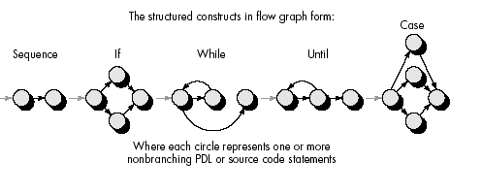
a. Flow Graph Notation

Slide 56
b. Cyclomatic Complexity
A software metric that provides a quantitative measure of the logical complexity of a program.
Value computed for cyclomatic complexity defines the number of independent paths in the basis set of a program
Provides an upper bound for the number of tests that must be conducted to ensure that all statements have been executed at least once.

Slide 57
b. Cyclomatic Complexity
An independent path must move along at least one edge that has not been traversed before the path is defined.
An independent path is any path through the program that introduces at least one new set of processing statements or a new condition.
3
Path1: 1-6
Path1: 1-2-3-5-6
1
2
5
6
Path1: 1-2-4-5-6
4
Path1: 1-2-4-6

Slide 58
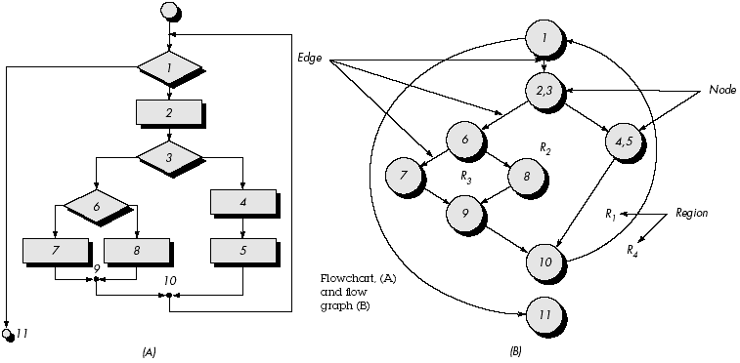
b. Cyclomatic Complexity

Slide 59
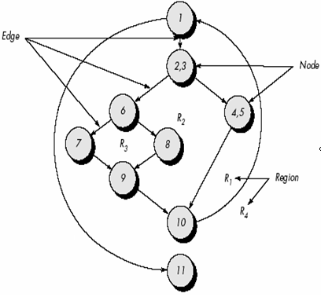
Set of Independent Paths
path 1: 1-11
path 2: 1-2-3-4-5-10-1-11
path 3: 1-2-3-6-8-9-10-1-11
path 4: 1-2-3-6-7-9-10-1-11
Each new path introduces a new edge.
The path 1-2-3-4-5-10-1-2-3-6-8-9-10-1-11 is an independent path?
Because it is simply a combination of already specified paths and does not traverse any new edges!!

Slide 60
Set of Independent Paths
Paths 1, 2, 3, and 4 constitute a basis set for the flow graph.
If tests can be designed to force execution of these paths, every statement in the program will have been guaranteed to be executed at least one time and every condition will have been executed on its true and false sides.
The computation of cyclomatic complexity tells us how many paths to look for.

Slide 61
b. Computing Cyclomatic
Complexity:
The number of regions of the flow graph correspond to the Cyclomatic Complexity.
Cyclomatic complexity, V(G), for a flow graph, G, is defined as V(G) = E - N + 2
E is the number of flow graph edges
N is the number of flow graph nodes.
iii. Cyclomatic complexity, V(G), for a flow graph, G, is also defined as V(G) = P + 1 where P is the number of predicate nodes contained in the flow graph G.

Slide 62
b. Computing Cyclomatic
Complexity:
1. The flow graph has four regions.
2. V(G) = 11 edges - 9 nodes + 2 = 4.
3. V(G) = 3 predicate nodes + 1 = 4.
Therefore, the cyclomatic complexity of the flow graph is 4.

Slide 63
c. Deriving Test Cases
Average procedure contains compound conditions and loops.
The basis path testing method can be applied to a procedural design or to source code.

Slide 64
Example
1. Using the design or code as a foundation, draw a corresponding flow graph.
A flow graph is created using the symbols and construction rules
Referring to the PDL for average, a flow graph is created by numbering those PDL statements that will be mapped into corresponding flow graph nodes.

Slide 65
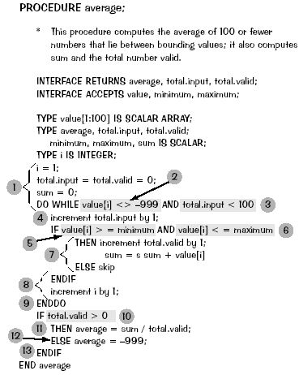
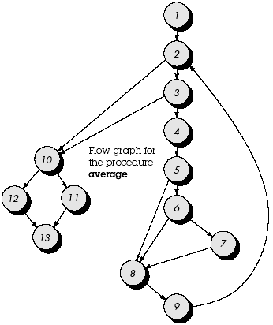

Slide 66
Example
2. Determine the cyclomatic complexity V(G) of the resultant flow graph.
i. V(G) = 6 regions
ii. V(G) = 5 predicate nodes + 1 = 6
iii. V(G) = 17 edges - 13 nodes + 2 = 6

Slide 67
Example
3. Determine a basis set of linearly independent paths. The value of V(G) provides the number of linearly independent paths through the program control structure.
In the case of procedure average, we expect to specify six paths:
path 1: 1-2-10-11-13
path 2: 1-2-10-12-13
path 3: 1-2-3-10-11-13
path 4: 1-2-3-4-5-8-9-2-. . .
path 5: 1-2-3-4-5-6-8-9-2-. . .
path 6: 1-2-3-4-5-6-7-8-9-2-. . .

Slide 68
Example
4. Prepare test cases that will force execution of each path in the basis set.
Data should be chosen so that conditions at the predicate nodes are appropriately set as each path is tested.

Slide 69
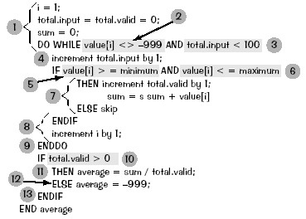
Example
Test cases that satisfy the basis set just described are:
Path 1 test case:
value(k) = valid input, where k < i for 2 ≤ i ≤ 100
value(i) = -999 where 2 ≤ i ≤ 100
Expected results: Correct average based on k values and proper totals.
path 1: 1-2-10-11-13

Slide 70
Example
Path 2 test case:
value(1) = -999
Expected results: Average = -999; other totals at initial values.
path 2: 1-2-10-12-13

Slide 71
Example
Path 3 test case:
Attempt to process 101 or more values.
First 100 values should be valid.
Expected results: Same as test case 1.
path 3: 1-2-3-10-11-13

Slide 72
Example
Path 4 test case:
value(i) = valid input where i < 100
value(k) < minimum where k < i
Expected results: Correct average based on k values and proper totals.
path 4: 1-2-3-4-5-8-9-2-. . .

Slide 73
Example
Path 5 test case:
value(i) = valid input where i < 100
value(k) > maximum where k <= i
Expected results: Correct average based on n values and proper totals.
path 5: 1-2-3-4-5-6-8-9-2-. . .

Slide 74
Example
Path 6 test case:
value(i) = valid input where i < 100
Expected results: Correct average based on n values and proper totals.
Each test case is executed and compared to expected results.
path 6: 1-2-3-4-5-6-7-8-9-2-. . .

Slide 75
Example
Once all test cases have been completed, the tester can be sure that all statements in the program have been executed at least once.

Slide 76
d. Graph Matrices
Used to develop a software tool that assists in basis path testing
A graph matrix is a square matrix whose size (i.e., number of rows and columns) is equal to the number of nodes on the flow graph.

Slide 77
d. Graph Matrices
Each row and column corresponds to an identified node, and matrix entries correspond to connections (an edge) between nodes.
Each node on the flow graph is identified by numbers, while each edge is identified by letters.

Slide 78
d. Graph Matrices
A letter entry is made in the matrix to correspond to a connection between two nodes.
For example, node 3 is connected to node 4 by edge b.

Slide 79
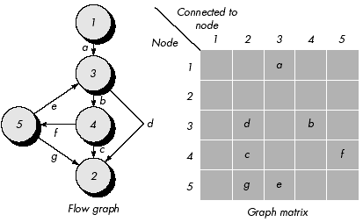
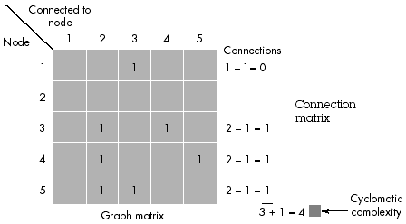
d. Graph Matrices

Slide 80
d. Graph Matrices
By adding a link weight to each matrix entry, the graph matrix can become a powerful tool for evaluating program control structure during testing.
The link weight provides additional information about control flow.
In its simplest form, the link weight is 1 (a connection exists) or 0 (a connection does not exist).

Slide 81
d. Graph Matrices
But link weights can be assigned other, more interesting properties:
• The probability that a link (edge) will be executed.
• The processing time expended during traversal of a link.
• The memory required during traversal of a link.
• The resources required during traversal of a link.
Each letter has been replaced with a 1, indicating that a connection exists (zeros have been excluded for clarity).
Represented in this form, the graph matrix is called a connection matrix.
Each row with two or more entries represents a predicate node.
Performing the arithmetic shown to the right of the connection matrix provides us with still another method for determining cyclomatic complexity

Slide 82
CONTROL STRUCTURE TESTING
The basis path testing technique is one of a number of techniques for control structure testing.

Slide 83
i. Condition Testing
Condition testing is a test case design method that exercises logical conditions contained in a program module.
A relational expression takes the form:
E1 <relational-operator> E2
where E1 and E2 are arithmetic expressions and <relational-operator> is one of the following: <, ≤, =, ≠ (non equality), >, or ≥.

Slide 84
i. Condition Testing
A compound condition is composed of two or more simple conditions, Boolean operators, and parentheses.
Boolean operators allowed in a compound condition include OR (|), AND (&) and NOT (¬).

Slide 85
Types of errors in a condition:
• Boolean operator (incorrect/missing/extra Boolean operators), variable, parenthesis error.
• Arithmetic expression error.
• Relational operator error.

Slide 86
i. Condition Testing
For a relational expression of the form E1 <relational-operator> E2
3 tests are required to make the value of E1 greater than, equal to, or less than that of E2.
If <relational-operator> is incorrect and E1 and E2 are correct, then these three tests guarantee the detection of the relational operator error.
To detect errors in E1 and E2, a test that makes the value of E1 greater or less than that of E2 should make the difference between these two values as small as possible.

Slide 87
i. Condition Testing
For a Boolean expression with n variables, all of 2n possible tests are required (n > 0).
For a Boolean variable, B, we specify a constraint on the outcome of B that states that B must be either true (t) or false (f).
Similarly, for a relational expression, the symbols >, =, < are used to specify constraints on the outcome of the expression.

Slide 88
Example:
First Condition
C1: B1 & B2
where B1 and B2 are Boolean variables.
The value (t, f) is a condition constraint for C1 and is covered by the test that makes the value of B1 to be true and the value of B2 to be false.

Slide 89
Example:
The constraint set {(t, t), (f, t), (t, f)} is covered by the executions of C1.
If C1 is incorrect due to one or more Boolean operator errors, at least one of the constraint set will force C1 to fail.

Slide 90
Example:
Second Condition
C2: B1 & (E3 = E4)
where B1 is a Boolean expression and E3 and E4 are arithmetic expressions.

Slide 91
Example:
A condition constraint for C2 is (D1, D2), where each of D1 is t or f and D2 is >, =, <.

Slide 92
Example:
Since C2 is same as C1 except the second simple condition in C2 is a relational expression,
Construct a constraint set for C2 modifying the constraint set {(t, t), (f, t), (t, f)} defined for C1.

Slide 93
Example:
Note that t for (E3 = E4) implies = and that f for (E3 = E4) implies either < or >.
By replacing (t, t) and (f, t) with (t, =) and (f, =), respectively, and by replacing (t, f) with (t, <) and (t, >),
The resulting constraint set for C2:
{(t, =), (f, =), (t, <), (t, >)}.

Slide 94
Example:
Third Condition
C3: (E1 > E2) & (E3 = E4)
where E1, E2, E3, and E4 are arithmetic expressions.

Slide 95
Example:
A condition constraint for C3 is of the form
(D1, D2), where each of D1 and D2 is >, =, <.
Since C3 is the same as C2 except that the first simple condition in C3 is a relational expression, Construct a constraint set for C3 by modifying the constraint set for C2
{(>, =), (=, =), (<, =), (>, >), (>, <)}

Slide 96
Example:
Coverage of this constraint set will guarantee detection of relational operator errors in C3.

Slide 97
ii. Data Flow Testing
The data flow testing method selects test paths of a program according to the locations of definitions and uses of variables in the program.
For a statement with S as its statement number,
DEF(S) = {X | statement S contains a definition of X}
USE(S) = {X | statement S contains a use of X}
For statement S: a = b+c; DEF(S) = {a} USES(S) = {b,c}
Definition of variable X at statement S is said to be live at statement S1 if there exists a path from statement S to statement S1which does not contain any definition of X

Slide 98
iii. Loop Testing
Loop testing is a white-box testing technique that focuses exclusively on the validity of loop constructs.
Four different classes of loops can be defined:
i. Simple loops
ii. Concatenated loops,
iii. Nested loops
iv. Unstructured loops .

Slide 99
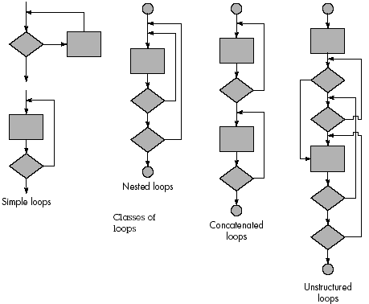
iii. Loop Testing

Slide 100
iii. Loop Testing
Simple loops. The following set of tests can be applied to simple loops, where n is the maximum number of allowable passes through the loop.
i. Skip the loop entirely.
ii. Only one pass through the loop.
iii. Two passes through the loop.
iv. m passes through the loop where m < n.
v. n - 1, n, n + 1 passes through the loop.

Slide 101
iii. Loop Testing
Nested loops. The number of possible tests grow geometrically as the level of nesting increases.
This would result in an impractical number of tests.
Steps for reducing the number of tests:
1. Start at the innermost loop. Set all other loops to minimum values.
2. Conduct simple loop tests for the innermost loop while holding the outer loops at their minimum iteration parameter values. Add other tests for out-of-range or excluded values.

Slide 102
iii. Loop Testing
3. Work outward, conducting tests for the next loop, but keeping all other outer loops at minimum values and other nested loops to "typical" values.
4. Continue until all loops have been tested.

Slide 103
iii. Loop Testing
Concatenated loops. Concatenated loops can be tested using the approach defined for simple loops, if each of the loops is independent of the other.
However, if two loops are concatenated and the loop counter for loop 1 is used as the initial value for loop 2, then the loops are not independent.
When the loops are not independent, the approach applied to nested loops is recommended.

Slide 104
iii. Loop Testing
Unstructured loops. Whenever possible, this class of loops should be redesigned to reflect the use of the structured programming constructs.

